Slide 1
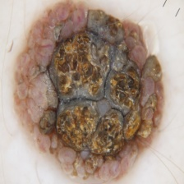
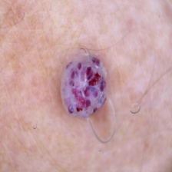
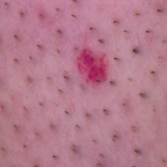
Few-shot learning
Recognise cancer type based on images
Model trained only on 5 images per class

Slide 2
Few-shot learning
We preprocessed the images, cropped exterior skin
We used both resnet-18 and our own backbone model
We achived accuracy of around 0.6 for cancer type, and around 0.8 for classifying malignant/benign cancer.

